Slide 1

TELEMATICS UNLEASHED
The Truth Behind Taxi Drivers
QWERTY
Sean Morrison, Daniel Bockle, Jean Marx, Sarah Ingram
23673656, 24015296, 23224258, 22798331

Slide 2
In this Presentation
01
The Taxi Problem
02
Our Approach
03
Risk Analysis
Overview
04
Towards a Driver Profile
05
Determining Driver Profiles
06
Fleet Management
07
Relevance to Mobalyz

Slide 3

A treasure trove of telematics data
While driver behaviour has been used for the everyday driver, providing individual solutions in the form of reports and recommendations, taxis have largely been overlooked.
Taxis present a uniquely South African problem that should be considered to better understand the driving landscape and its implications for owners and insurance companies.
Problem:
how can we create taxi-specific behaviour risk profiles to make up for this lack of information?
In a world of Big Data, the issue arises of turning this data into useful, ready, and easy-to-use information.
Constant monitoring of GPS systems and vehicle sensors has provided vast amounts of raw data on driving behaviour.
Problem:
how can we use these data stores to provide meaningful driver information for both the driver and other stakeholders?
The Taxi Problem
Interpreting Taxi behaviour

Slide 4


QWERTY's Approach
how did we go about solving this problem?
01
02
03
04
05
Data Analysis
+
Data Cleaning
Categorising Driver risk
Developing a Driver profile
Determining Driver behaviour profiles
Fleet Management
(Owner POV)
(Insurance POV)
github repository

Slide 5
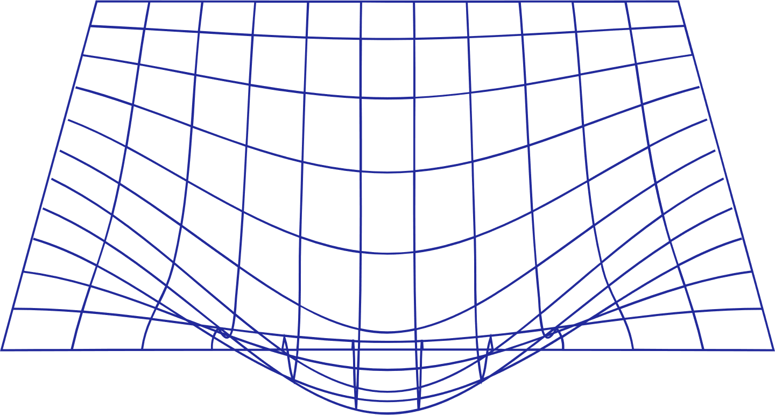

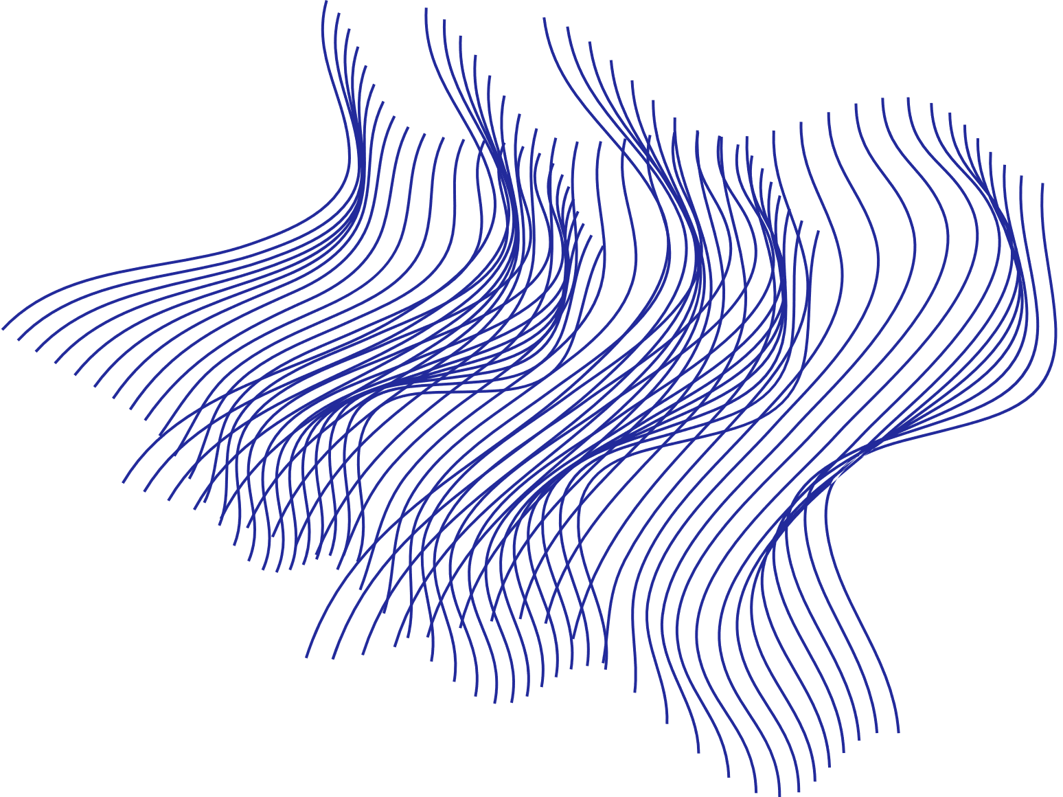

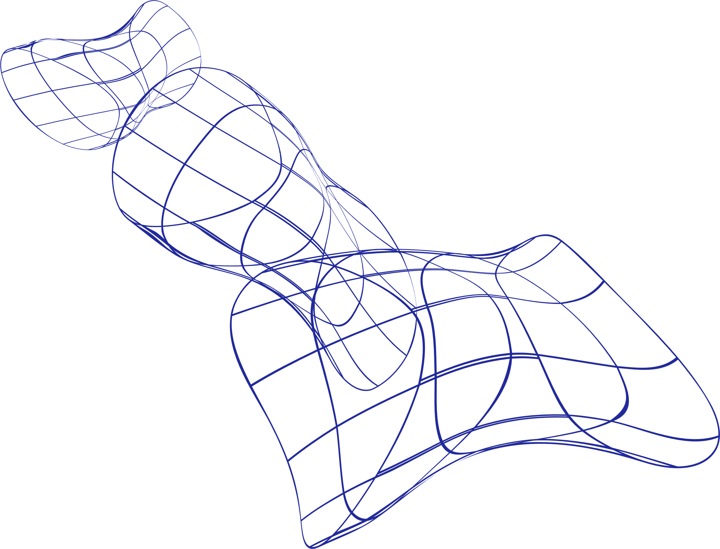

Historical Claims
Total claims per car
Total cost per car
Average cost per claim
Acceleration Risk
Braking Risk
Risky acceleration behaviour based on positive linear g
Risky braking behaviour based on negative linear g
Risk Analysis
how did we classify risky taxi behaviour?
Cornering Risk
Shift Risk
Speeding Risk
Cornering behaviour based on lateral g
Risk rating based on driving during 'risky' hours
Average speed over the limit per area

Slide 6
Risk Classification
Given the six characteristics considered during the risk analysis, we determine the driver's risk rating by taking an average of these factors.
Driver Profile
Driving Behaviour
how will we categorise taxi drivers?
Determining the average time each driver spends behind the wheel and the distance they cover per day.

Slide 7
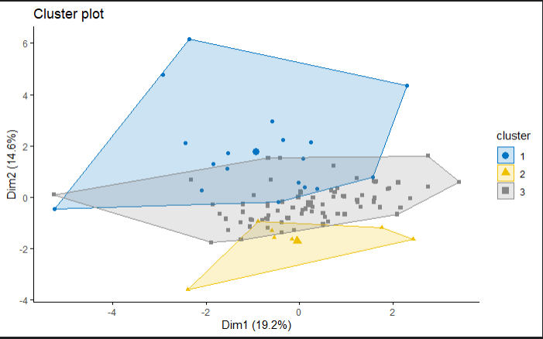
what did we find?
Determining Driver Profiles
Through the creation of Driver Profiles, by combining Driver Risk Classification and Driving Behaviour, QWERTY was able to identify three clusters that each of the taxis fell under.
Of the total 106 taxis, QWERTY's model identified 5 vehicles that exhibited behaviour that matched two of the three clusters. This signalled that these 5 taxis had two active drivers at the time that the data was collected.

Slide 8
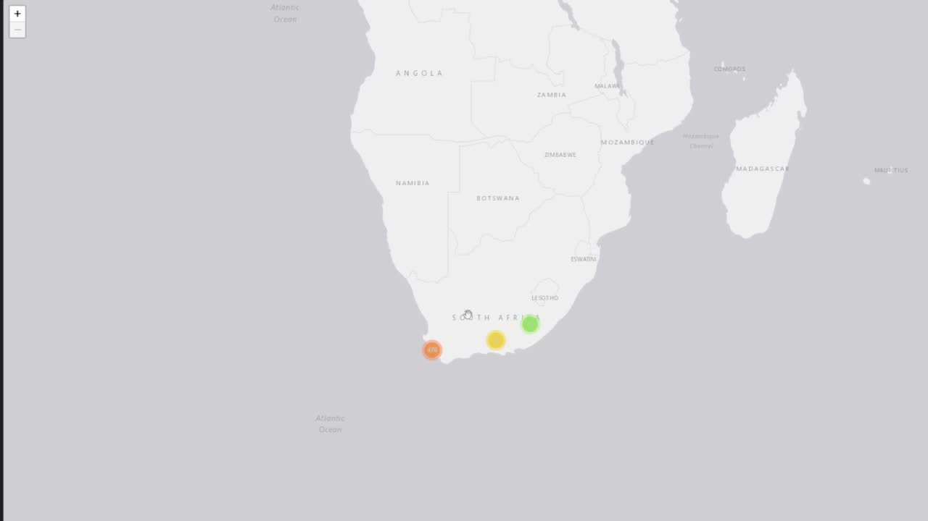
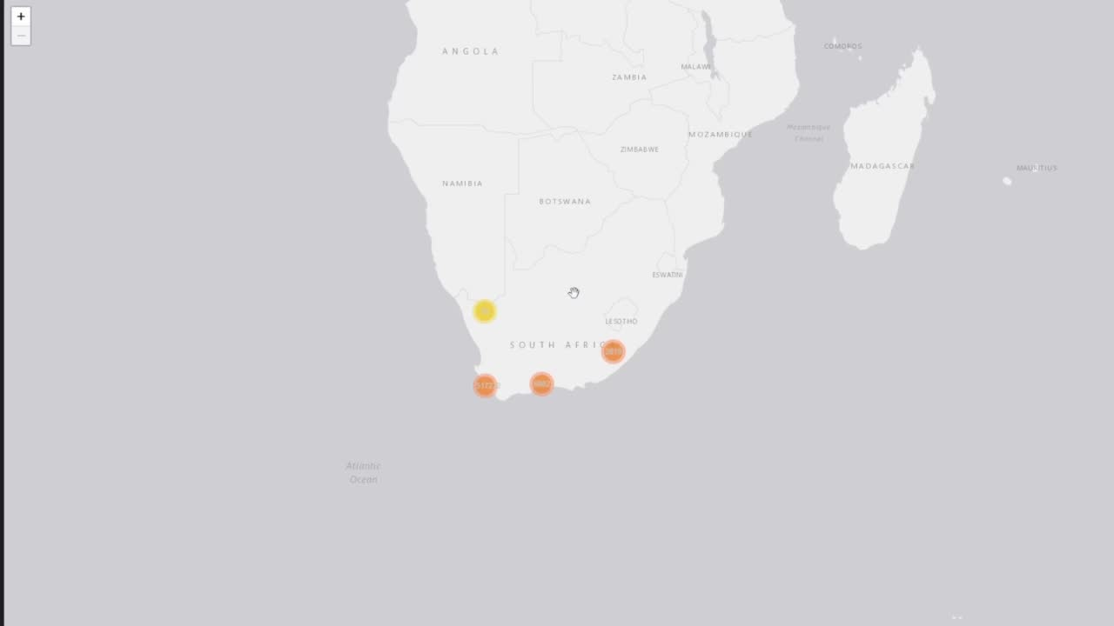
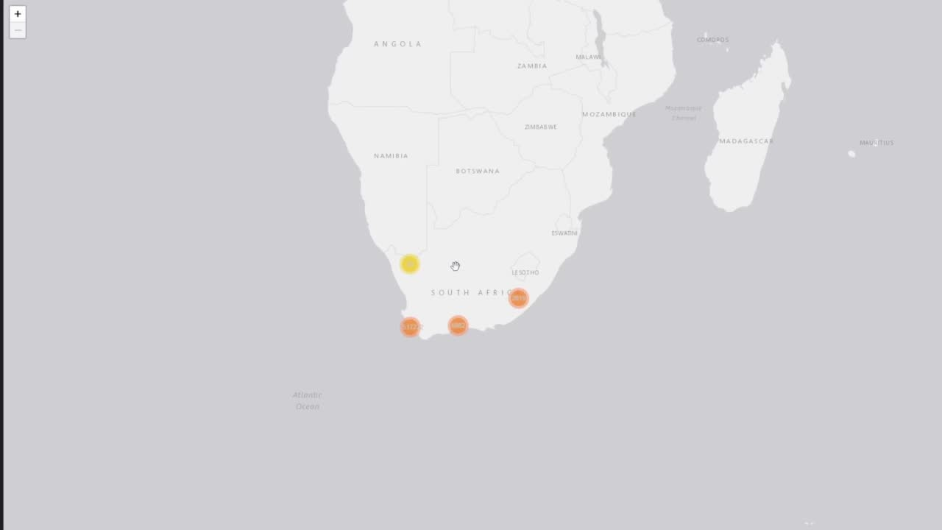
Fleet Management
what about the owner?
For taxi owners, perhaps the most crucial part is the geographical visualisation of their fleet. QWERTY's Fleet Management, therefore, focuses on interactive maps for vehicle owners to identify areas where taxis speed, idle, and lose GPS connection.
Speeding occurences
GPS Loss/Lock
Idling occurences
(There are videos but due to PDF format they will not play – please see GitHub for videos)

Slide 9

what's in it for Mobalyz?
Relevance to Mobalyz
a mobility platform
Customer-facing solutions
Creation of a user-friendly geographical visualisation system for taxi data.
Risk analysis of vehicles within a customer's fleet.
Risk classification of drivers based on performance metrics.
Insurance-facing solutions
Personalised insurance policies based on the risk of the selected driver.
Recommendations of drivers based on their Driver Profile.
Creation of a geographical visualisation system for taxi data to identify problematic areas.

Slide 10


Thank You!
love, QWERTY <3

